Slide 1
Who ya gonna call? 988 Regional call center
Jacque Kobuchi-Clinical services director
Kari Norris- Emergency services coordinator

Slide 2
Historically…
When in crisis, Virginians utilized:
Emergency Services 24 hour crisis line at all 40 CSBs
RACSB’s number: (540) 373-6876
National Suicide Hotline

Slide 3
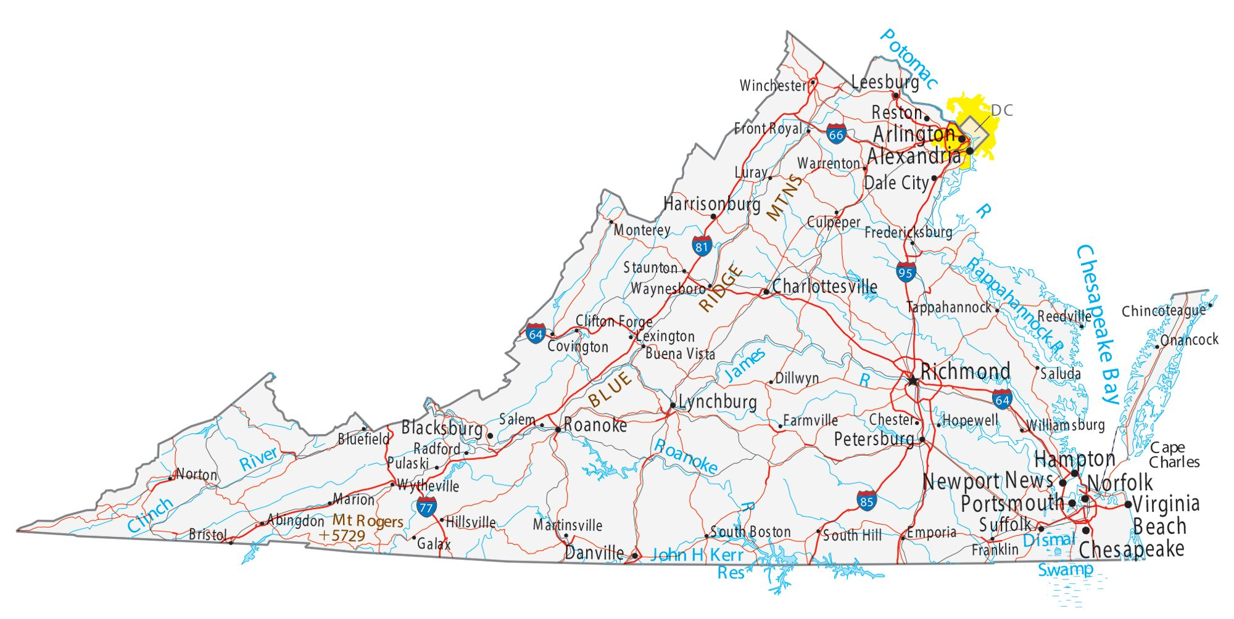
So begins STEP-VA/Project Bravo

Slide 4
STEP-
VA

Slide 5
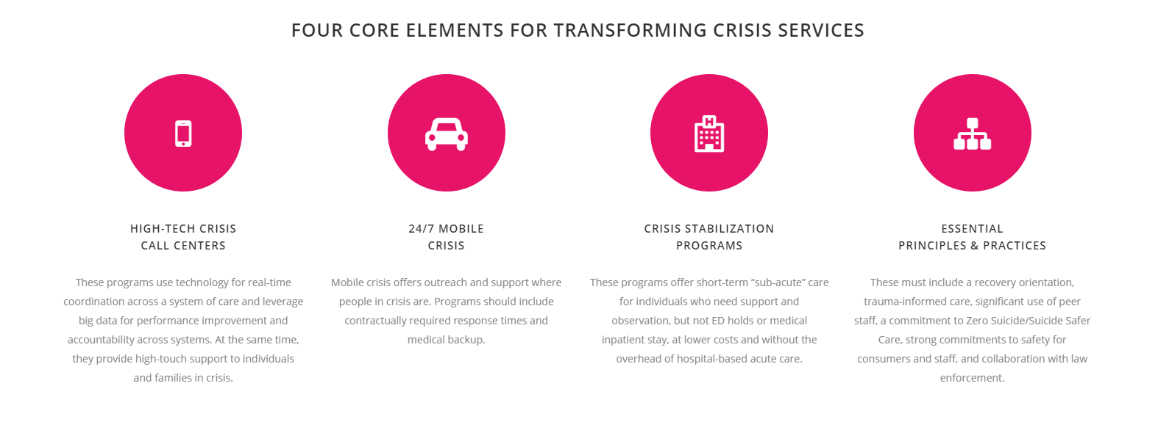
Crisis Now Model

Slide 6
High Tech Crisis Call Centers
Unified Data Platform
Management of the flow of the crisis system, triaging out calls which do not need a response and bringing in the National Suicide Prevention Lifeline/988 volume into a system of care
Dispatch Capability (real time oversight of responses for mobile teams, dispatching based on proximity and specialty
Outpatient Appointment Scheduling (care post call)
Engagement of Care Navigators
In-patient and Crisis Stabilization Bed Tracking
Access to up-to-date information and referrals for public mental health and private provider treatment

Slide 7
Marcus Alert
The “MARCUS Alert system” is defined as a set of protocols to:
initiate a behavioral health response to a behavioral health crisis, including for individuals experiencing a behavioral health crisis secondary to mental illness, substance abuse, developmental disabilities, or any combination thereof;
divert such individuals to the behavioral health or developmental services system whenever feasible; and
facilitate a specialized response in accordance with § 9.1-193 (note: this is the law enforcement-based response) when diversion is not feasible.
***Establishes the Call Center Fund through a cellphone tax generating $8-9 million annually for call center funding***

Slide 8
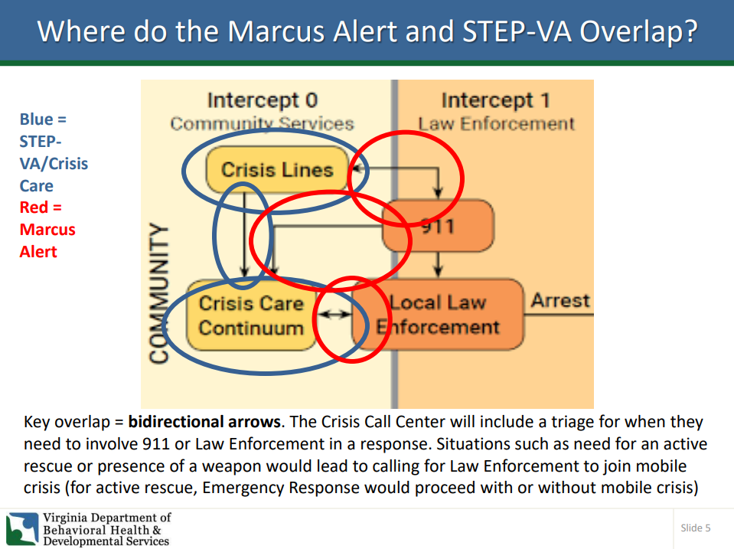
Marcus
Alert

Slide 9
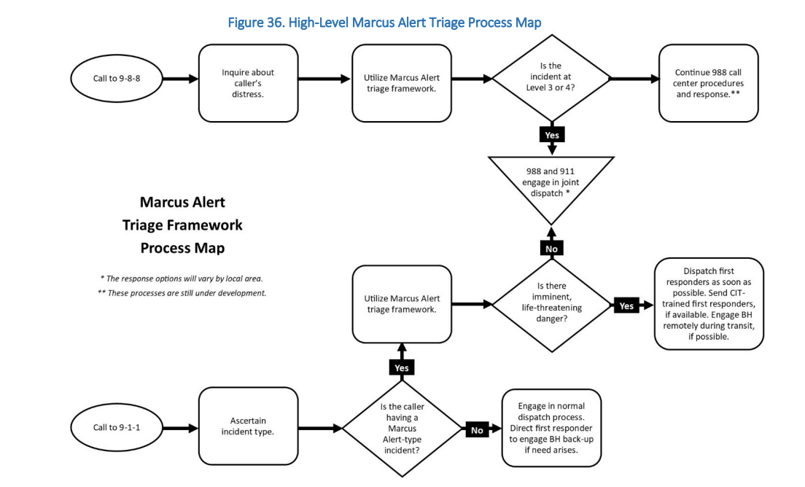
Marcus
Alert

Slide 10
9-8-8
On July 16, 2020, the FCC voted to designate 988 to be operational by July 16, 2022.
National campaigns begin in July 2023.
Chat, Text and Phone fully integrated into one platform
Capacity building within states has been ongoing for the past three years

Slide 11
How did Virginia respond to the call for 988
Virginia has created five regional call centers in alignment with the five regions
Four of the five utilize PRS for their call center management
Call centers went live in January 2022

Slide 12
Free & Confidential Crisis Intervention & Prevention Line
434-230-9704
Staffed by highly trained paraprofessional volunteers and crisis line workers
Available 24 hours a day, 7 days a week, 365 days a year
Do you need help with…
Feelings of anxiety, depression and overwhelm • Suicidal thoughts yourself or others • Relationship difficulties• Family dynamics • Information and support with mental health/illness • Homelessness • Trauma • Loneliness • Substance Use • Bullying • Discrimination • Financial problems • Issues affecting youth
Talk with the Regional Crisis Call Center!
Talk with an empathic person who cares about you
Find referrals to mental health and other community services
Get ideas and tips about how to help someone you’re concerned about
What to expect when you call:
A safe place to share your thoughts, feelings and experiences.
A warm space to weigh out your options and needs.
Information and referral to additional care post-call.
Safety planning when you are struggling with suicidal thoughts.
Someone to listen when you feel most alone.
You can learn more about PRS CrisisLink at www.prsinc.org/crisislink

Slide 13
How does RACSB interface with 988?
Emergency Services staff are regularly providing the number to individuals who call in crisis
Outpatient/Case management/Sunshine Lady House and other programs have all been encouraged to utilize this number
Two way integration where the call center also refers back to RACSB to provide ongoing care
RACSB staff are involved in the implementation of a triage system that will tie in 988, Step-VA, Marcus Alert, regional mobile crisis programs, local mobile crisis and our Emergency Services Team.

Slide 14
Regional call center stats
Number of calls offered | February | March | April | May | June | July
Rapp A-Caroline # | <6 |  | <6 | <6 | <6 | No data
Rapp A-Fredericksburg # | 59 | <6 | 125 | 68 | 46 | 64
Rapp A-King George # | <6 | No data | <6 | <6 | <6 | No data
Rapp A-Spotsylvania # | 12 | 16 | 18 | 18 | 19 | 27
Rapp A-Stafford # | 41 | 56 | 38 | 62 | 54 | 62

