Slide 1
RACSB
Fiscal Year 2027
Operating Budget
June 16, 2026

Slide 2
Budget Highlights

Slide 3
Budget Challenges and Changes (Continued)

Slide 4
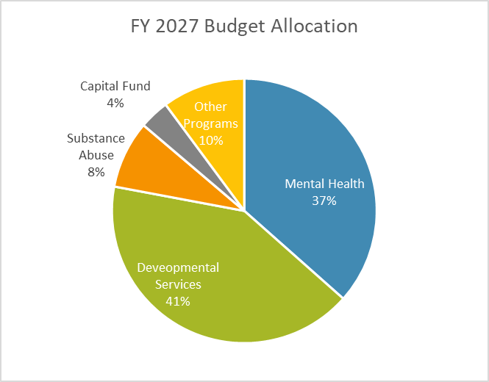
Budget - All Programs

Slide 5
Performance Contract Programs
*Cash Basis Budget (excludes accruals and depreciation)

Slide 6
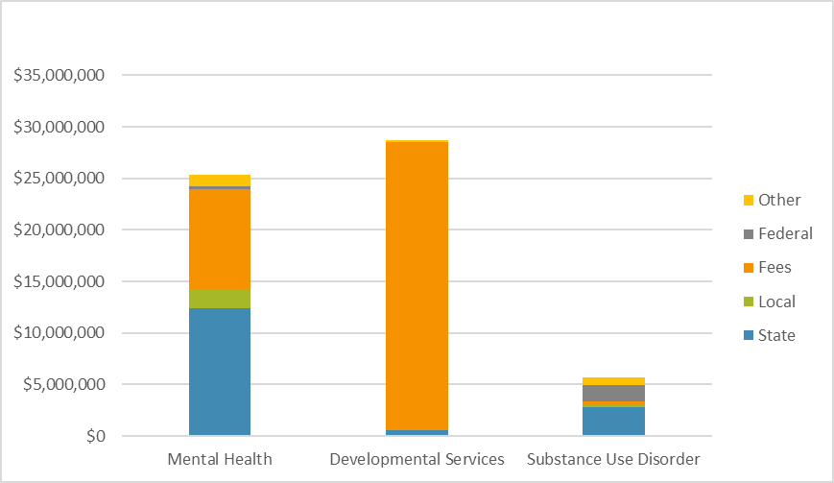
Performance Contract Budget by Source

Slide 7
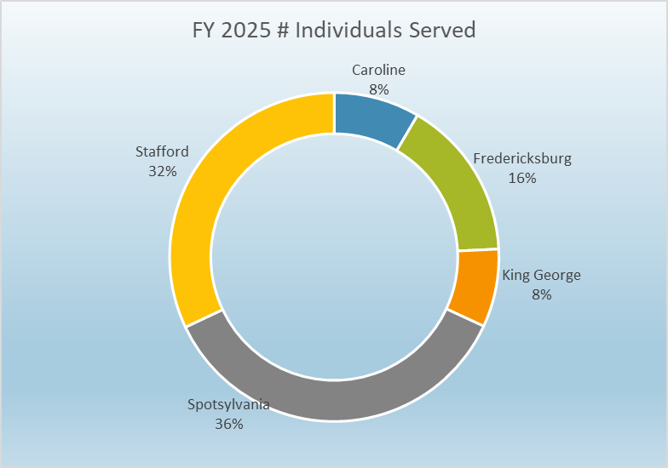
Performance Contract – Local Funding

Slide 8
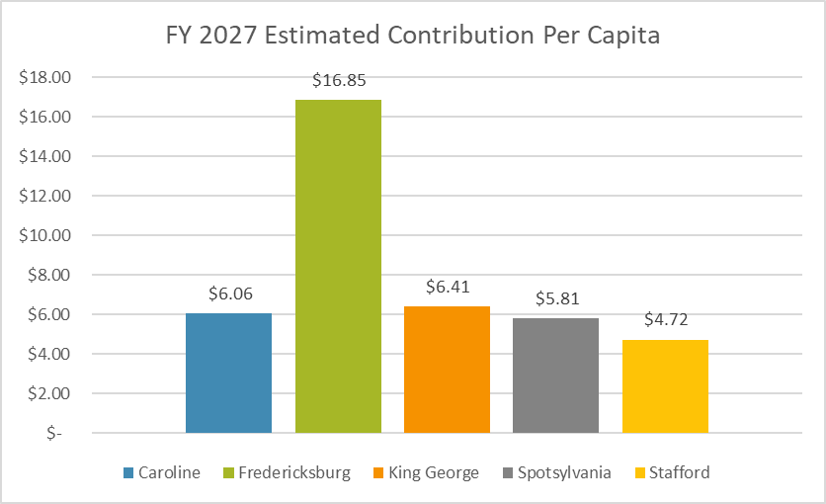
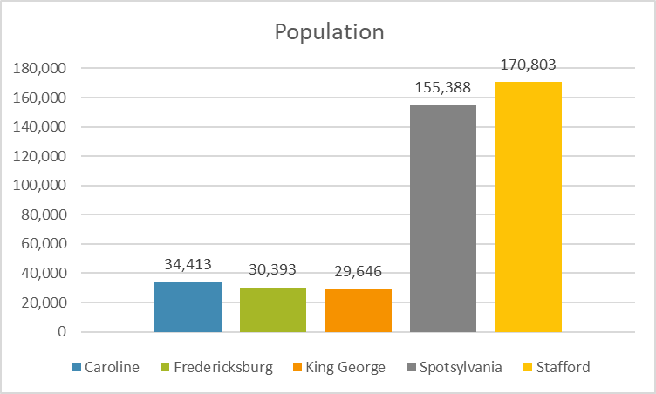
Performance Contract – Local Funding Continued
*US Census Data utilized, estimated population as of July 1, 2025

Slide 9
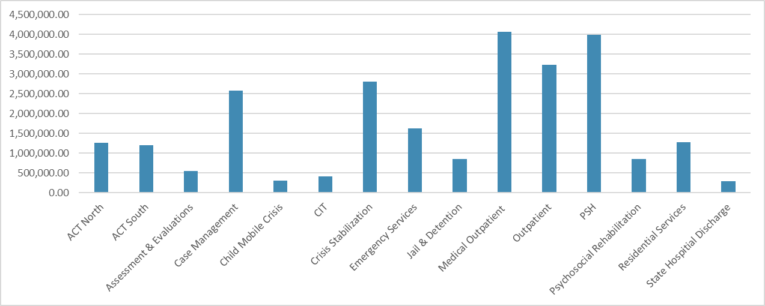
Estimated Cost by Program – Mental Health

Slide 10
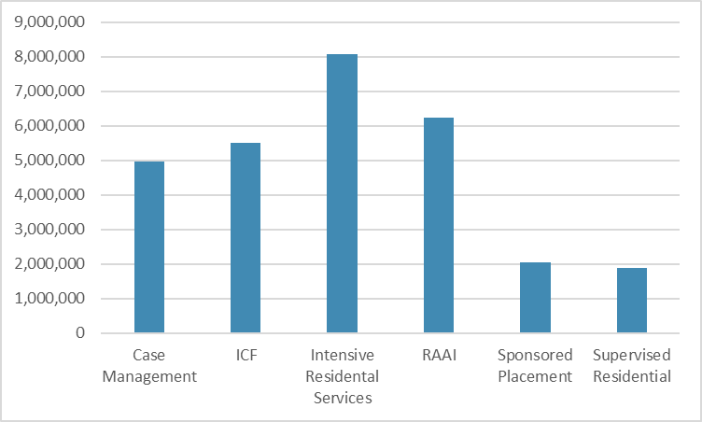
Estimated Cost by Program – Developmental Services

Slide 11
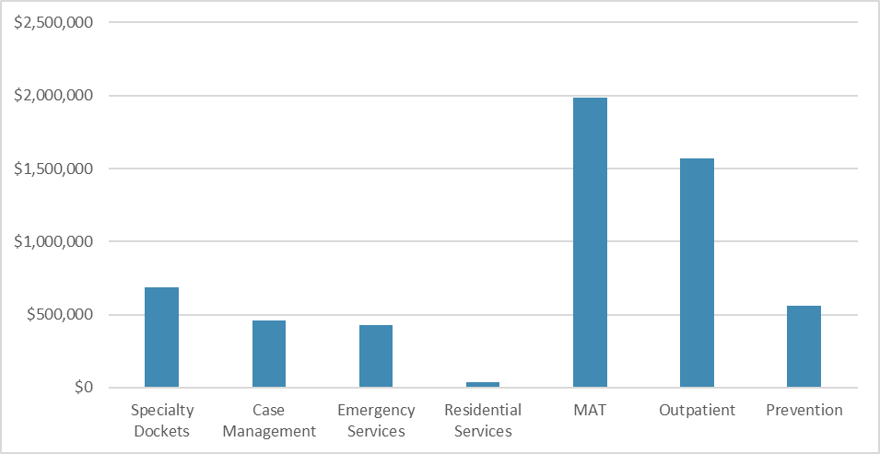
Estimated Cost by Program – Substance Abuse Services

Slide 12
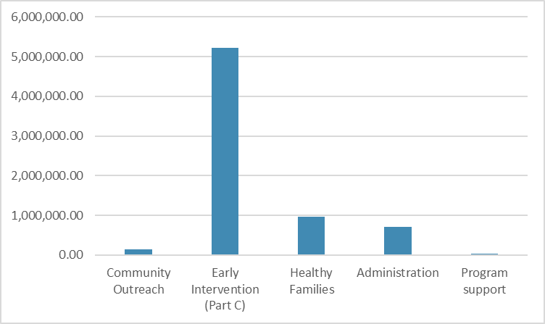
Estimated Cost by Program – Non Performance Contract Programs

Slide 13
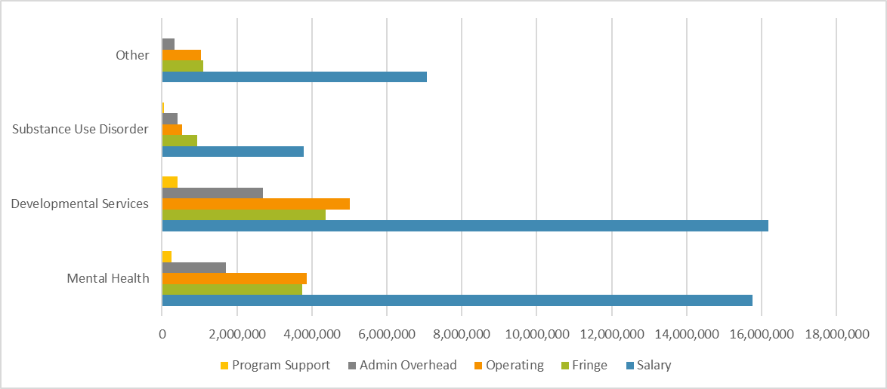
Performance Contract Expenses

Slide 14
Programs Requiring Fee Transfer Support

Slide 15
Fiscal Year 2026 Successes
Recruitment/Retention – Additional Compensation one time bonus approved and implemented in July 2025
Continued to lower health insurance claims allowing for low rates and a temporary insurance premium holiday
Continued focus on increasing interest by increasing investment in LGIP and joining MINT
Focus on collections and reducing denied claims
Increased utilization in most programs

Slide 16
Fiscal Year 2026 Challenges
Recruitment and Retention (some programs)
Meeting increased level of administrative and programmatic requirements.
Funding Sources – Ensuring programs document expenses with funding sources, where applicable
Residential Vacancies
Funding Source Financial uncertainty
Performance Contract- Federal Reimbursement Process
Crisis Receiving Center (CRC)/Office Space

Slide 17
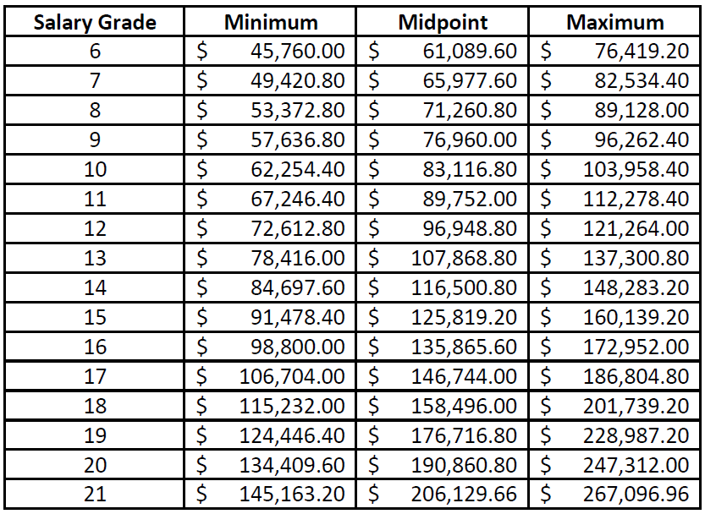
FY 2027 - Proposed Classification/Compensation Scale

Slide 18
FY 2027 Proposed Merit Increase
Merit increase based on overall performance score on employee evaluations from December 2025 and May 2026.
Increase to begin with July 10th pay date (pay period June 21 – July 4)
Proposed increase percentages:

Slide 19
Action items
FY 2027 Proposed Budget
FY 2027 Proposed Classification and Compensation Scale
Proposed Merit Salary Increase

